Slide 1
CS3210 Tutorial 1
Tutorial: Parallel Computer Architecture
Lab: Slurm
Please don’t start on part 2/3 of the tutorial yet.
Theodore’s slides; heavily inspired by Sriram’s, Richard’s, Cristina’s and Zhi Heng’s slides.

Slide 2
Calibration / Improvements
After first tutorial :)

Slide 3
(pollev slide on speed and preferred material)

Slide 4
Quick Recap
Lecture 2+3, Tutorial 1, Lab 1

Slide 5
So Far: High-Level
Processes and Threads (Lec 2)
Processes and Threads (Lab 1)
Parallel Computing Architectures (Lec 3)
Parallel Computing Architectures (Tut 1)
Process basics and states
Memory regions
fork/wait
IPC (shared memory, message passing)
Threads as lightweight processes
Users vs kernel threads
Synchronization: pthread mutexes, semaphores, condition variables
Forms of parallelism (bit/instruction/thread/processor)
Flynn’s Taxonomy (SISD/SIMD/...)
Hierarchical vs Pipelined designs
How memory / cache is organized (distributed/shared/hybrid)

Slide 6
Focus: Forms of Parallelism
Single processor
Bit-level
Instruction-level
Thread-level
Processor-level
Shared memory
Distributed memory
Multiple processors

Slide 7
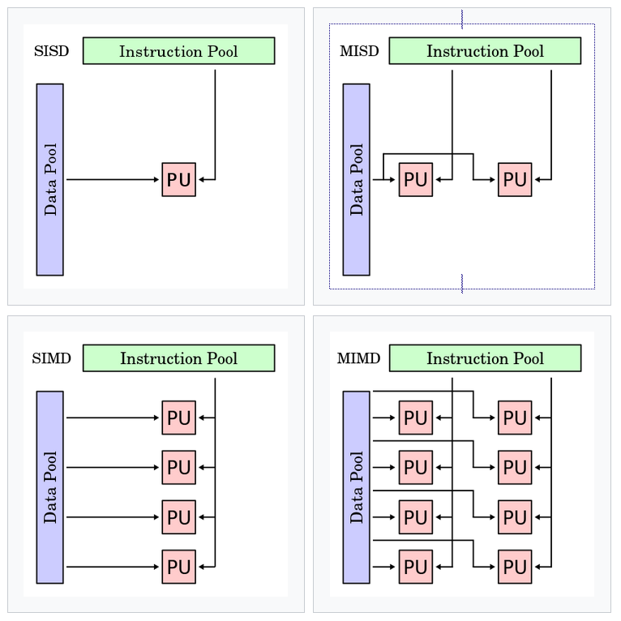
Focus: Flynn’s Taxonomy
Terminology to define different types of parallel architectures
Single / multi-instruction
How many independent streams of execution are there?
Single / multi-data
How many logical blocks of data are we trying to operate on?

Slide 8
Part 1: Tutorial Questions

Slide 9
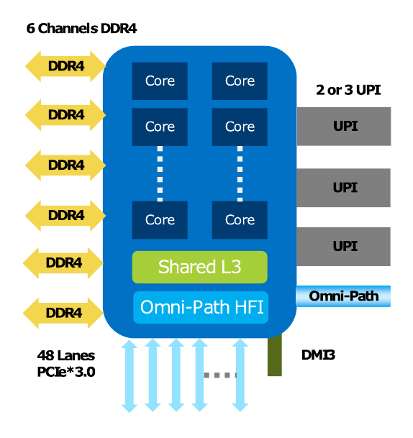
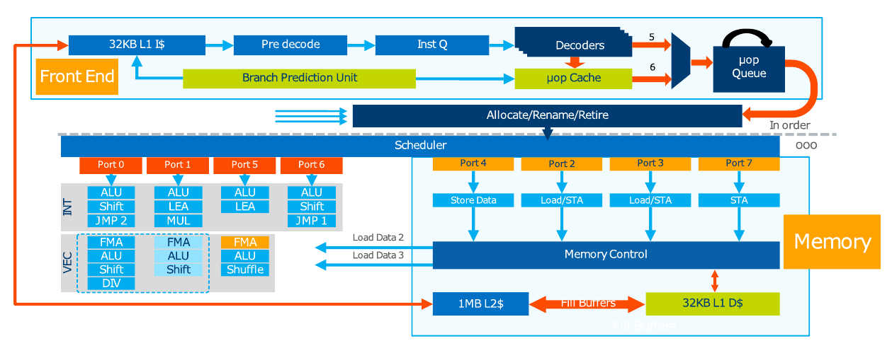
Q1: Identifying Forms of Parallelism
Determine where and how our processor supports parallelism
Don’t need to understand low-level details!
Googling should allow you to match Lecture 3 concepts to these “industry names”

Slide 10
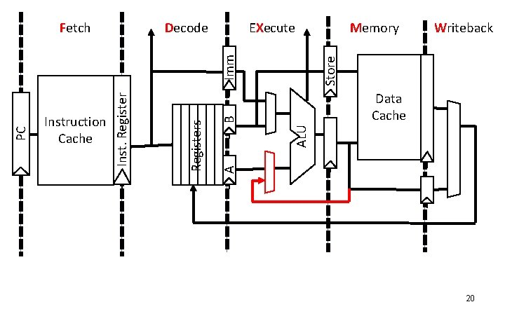
Mapping to CS2100
Decode
Fetch
Execute
Mem/WB

Slide 11
Q1: Identifying forms of parallelism
Q: Where do we have instruction-level parallelism? [p]

Slide 12
pollev slide

Slide 13
Q1: Identifying forms of parallelism
Q: Where do we have instruction-level parallelism?
One example of superscalar processing: multiple duplicated portions of the processor pipeline

Slide 14
Q1: Identifying forms of parallelism
Q: Where do we have thread-level parallelism? [p]

Slide 15
pollev slide

Slide 16
Q1: Identifying forms of parallelism
Q: Where do we have instruction-level parallelism?
This entire diagram represents the pipeline for one core with 2 hardware threads! They share the resources in the core.

Slide 17
Q1: Identifying forms of parallelism
Q: Where do we have processor-level parallelism? [p]

Slide 18
pollev slide

Slide 19
Q1: Identifying forms of parallelism
Q: Where do we have processor-level parallelism?
Each processor core runs individually: parallelism
Any more?

Slide 20
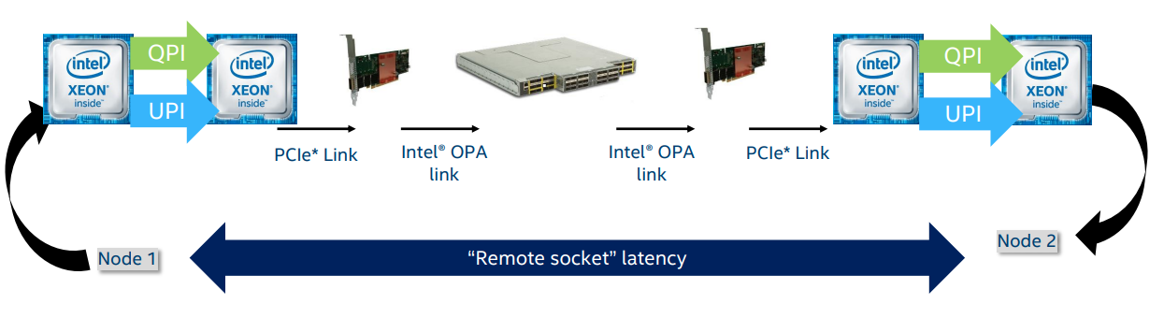
Q1: Identifying forms of parallelism
Q: Where do we have processor-level parallelism?
Intel UltraPath Interconnect (UPI): Processor to Processor (shared memory)
Intel OmniPath Architecture (OPA): Node to node (distributed memory)

Slide 21
Why does this matter?
When you run your code on certain hardware, you can make decisions about how to parallelize. Examples:
Node has multiple processors connected without high-speed interconnect? Maybe keep tasks to 1 processor.
Cores don’t have much superscalar ability? Maybe best to use simpler tasks over many cores.

Slide 22
Summary
Connecting to lab machines
Processes and threads
Mutexes / Semaphores / Condition Variables

Slide 23
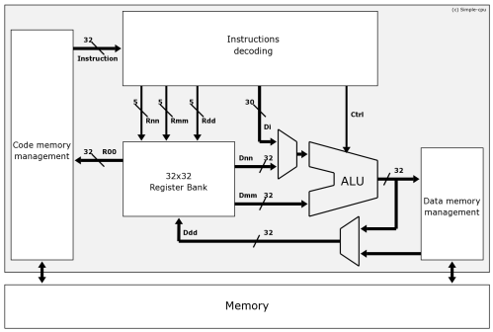
Q2: Flynn’s Taxonomy
What architecture for a personal computer from the 1980’s?
SISD: one instr and data stream

Slide 24
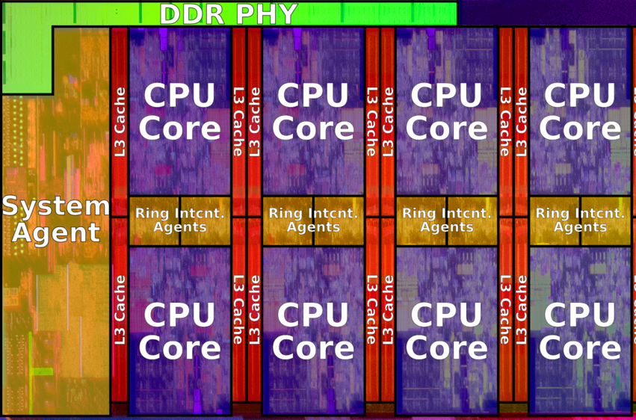
Q2: Flynn’s Taxonomy
What architecture for a multi-core processor laptop?
MIMD: Each core runs in parallel, independent data, or…

Slide 25
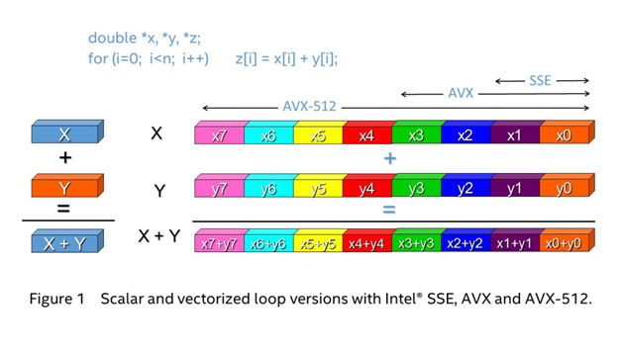
Q2: Flynn’s Taxonomy
What architecture for the Intel AVX instruction set?
SIMD: one instruction operates on multiple data blocks

Slide 26
Q2: Flynn’s Taxonomy
What architecture for a single core processor with pipelining?
SISD: same as first question

Slide 27

Q2: Flynn’s Taxonomy
Students in an exam hall?
MISD: same data (exam paper) but multiple independent streams (students)

Slide 28
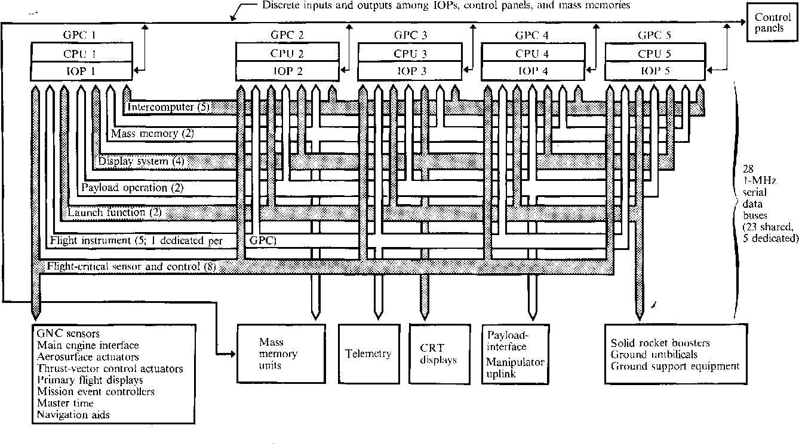
Interesting MISD: Space Shuttle CPUs
https://www.semanticscholar.org/paper/Redundancy-Management-Technique-for-Space-Shuttle-Sklaroff/eb225e9ad32eaeb29583ee0806d9381522de4959

Slide 29
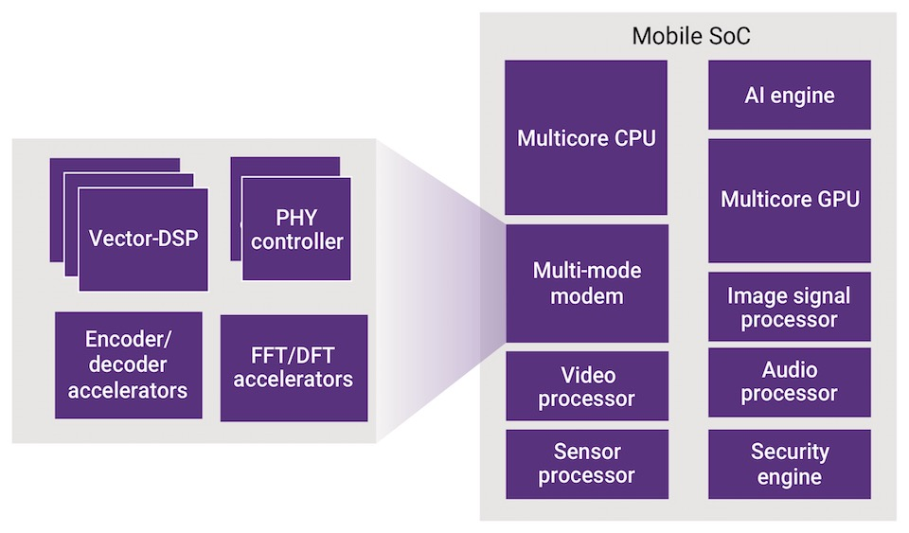
Why does this matter?
We see all kinds of specialized processors nowadays
Tradeoff between speed and generality
Taxonomies help us to understand the rough capabilities of new processing units

Slide 30
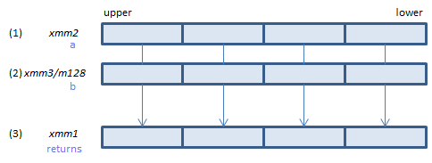
Quick look at AVX (SIMD) Instructions
Note - you don’t have to know details!
Just that such things (vector instructions) exist
https://godbolt.org/z/fbTeE4jb7
vpaddd

Slide 31
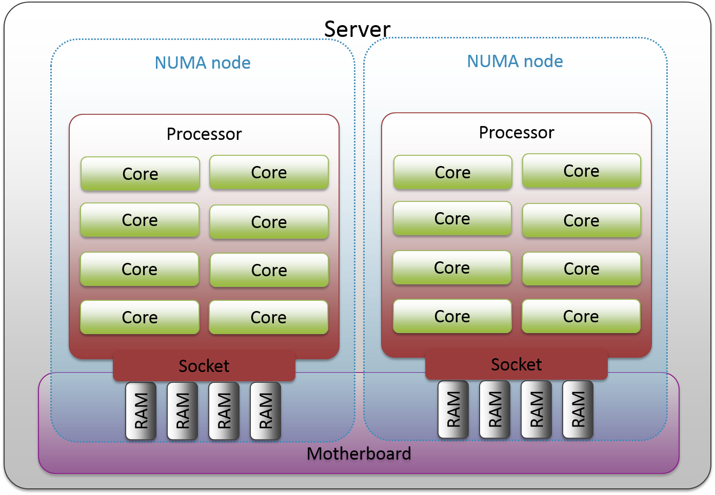
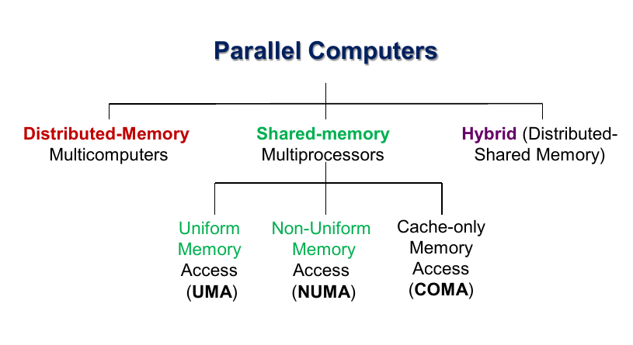
Q3: Memory & Multicore Architectures
Shared memory implies a UMA architecture? (T/F?)
No! Memory access need not be uniform!

Slide 32
Q3: Memory & Multicore Architectures
Answering Q2 at the same time: where your data is, is important in a NUMA architecture!

Slide 33
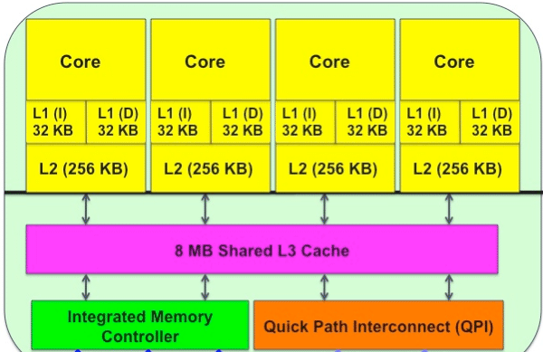
Q3: Memory & Multicore Architectures
In hierarchical multicore designs, is the memory organization hybrid (distributed + shared memory)?

Slide 34
pollev

Slide 35
Q3: Memory & Multicore Architectures
In hierarchical multicore designs, the memory organization is hybrid (distributed + shared memory)?
Both answers arguable!
Not hybrid: everyone just sees one shared memory
Hybrid: could see cache as its own memory that can be out of sync

Slide 36
Why does this matter?
The quirks of distributed / shared memory are crucial for fast parallel programs
Very small L1 caches? Your parallel programs may not benefit from accessing lots of individual data per core.
NUMA processors? Best to keep data organization in mind
A lot of performance can be squeezed out of good cache usage!

Slide 37
Q4: Processes and Threads
Q: Can a semaphore replace a mutex without affecting correctness? [p]

Slide 38
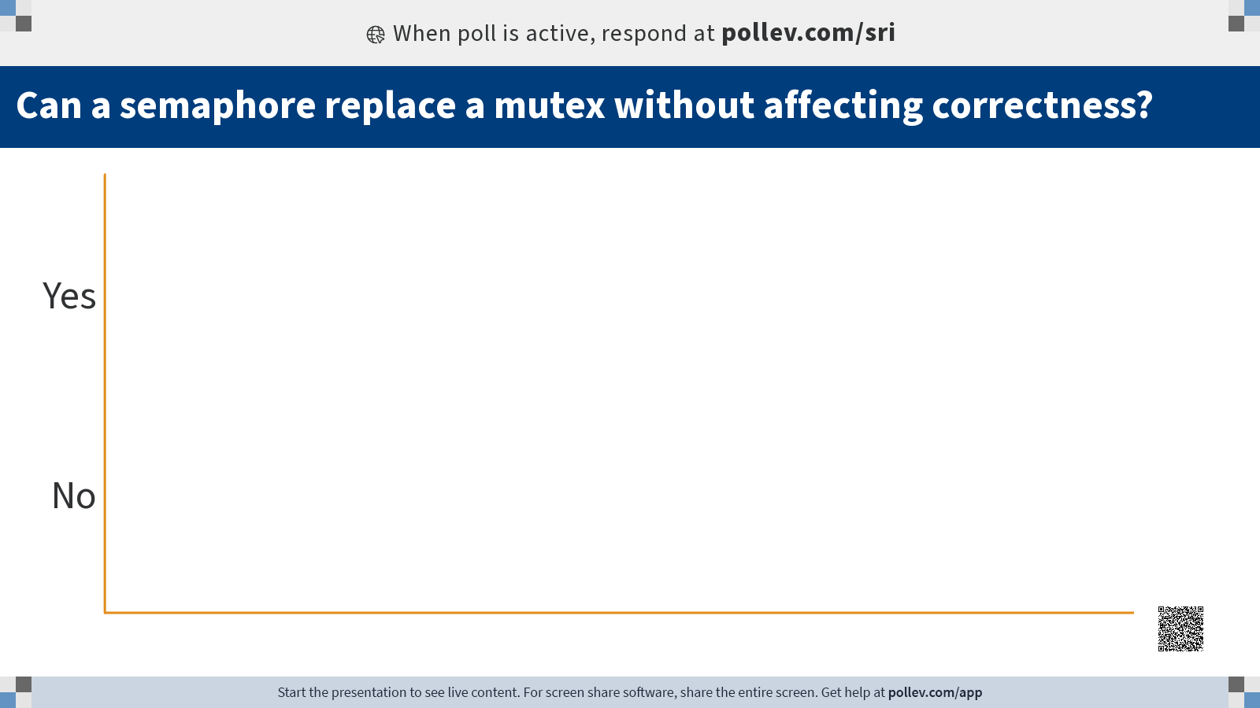

Slide 39
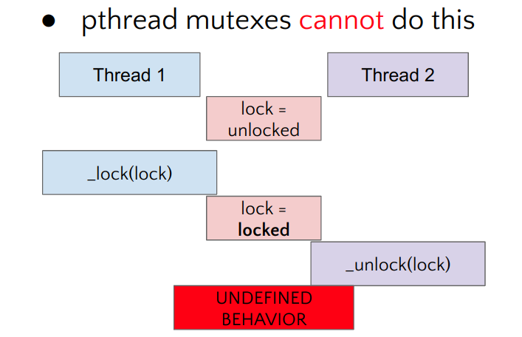
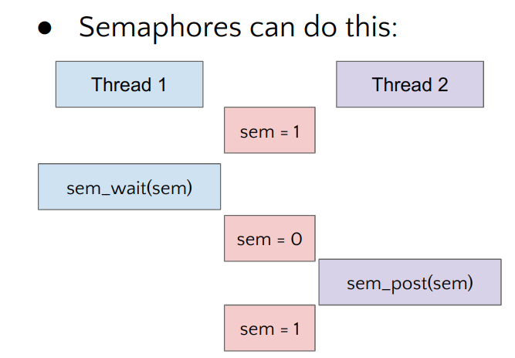
Q4: Processes and Threads
Can a semaphore replace a mutex without affecting correctness?
Yes! Semaphores are more general than mutexes, just set S = 1

Slide 40
Q4: Processes and Threads
Is a program implemented with threads faster than processes?

Slide 41
Q4: Processes and Threads
Is a program implemented with threads faster than processes?
Not necessarily, because:
Could be only user threads
Condition variable usage / other logic could be slower than semaphores sometimes
Rarely have such guarantees in systems work
Your mileage might vary for Lab 1!

Slide 42
Short break
Stretch, go to the toilet, buy drinks, or ask me questions
5 mins :D

Slide 43
Part 2+3: Slurm usage
Please follow at the same pace until later!

Slide 44
Part 2 & 3: Practical Slurm Usage
Please follow at the same pace until later

Slide 45
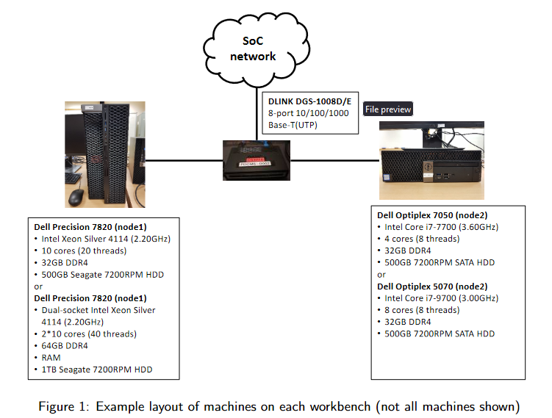
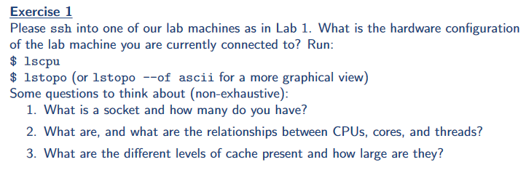
ex1: Login to a machine and run lstopo/lscpu
What’s the difference between sockets/cores/threads?

Slide 46
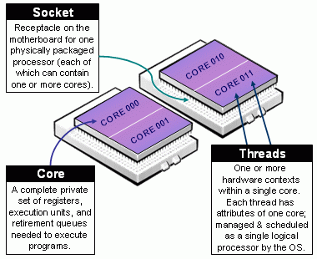
Socket vs Core vs Thread..
Thread: single hardware thread of execution
Core: single set of usable hardware for running code (registers, pipeline stages, some cache)
Cores * threads per core == lscpu CPUs → logical CPUs
Socket: where a full physical process fits (many cores)

Slide 47
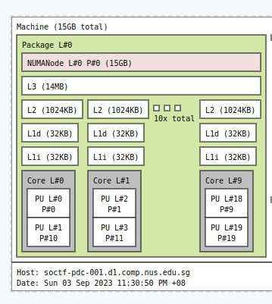
Understanding lstopo
lstopo --of svg

Slide 48

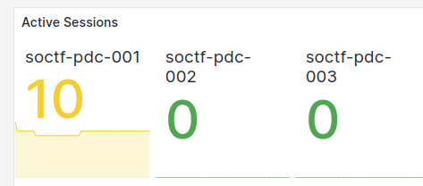
ex2: Lab Monitoring
Go to https://pdc.comp.nus.edu.sg/grafana
Login with your lab username and password
Click the “hamburger” menu on the top left side
Check out Home and Dashboards
Home - Overview of all nodes, including number of users logged in
“Sessions”
Login to nodes with fewer active sessions!
Dashboards - detailed “Node Exporter” dashboard

Slide 49
Introducing: Slurm Workload Manager
How you’re going to run most of your stuff in the lab machines

Slide 50
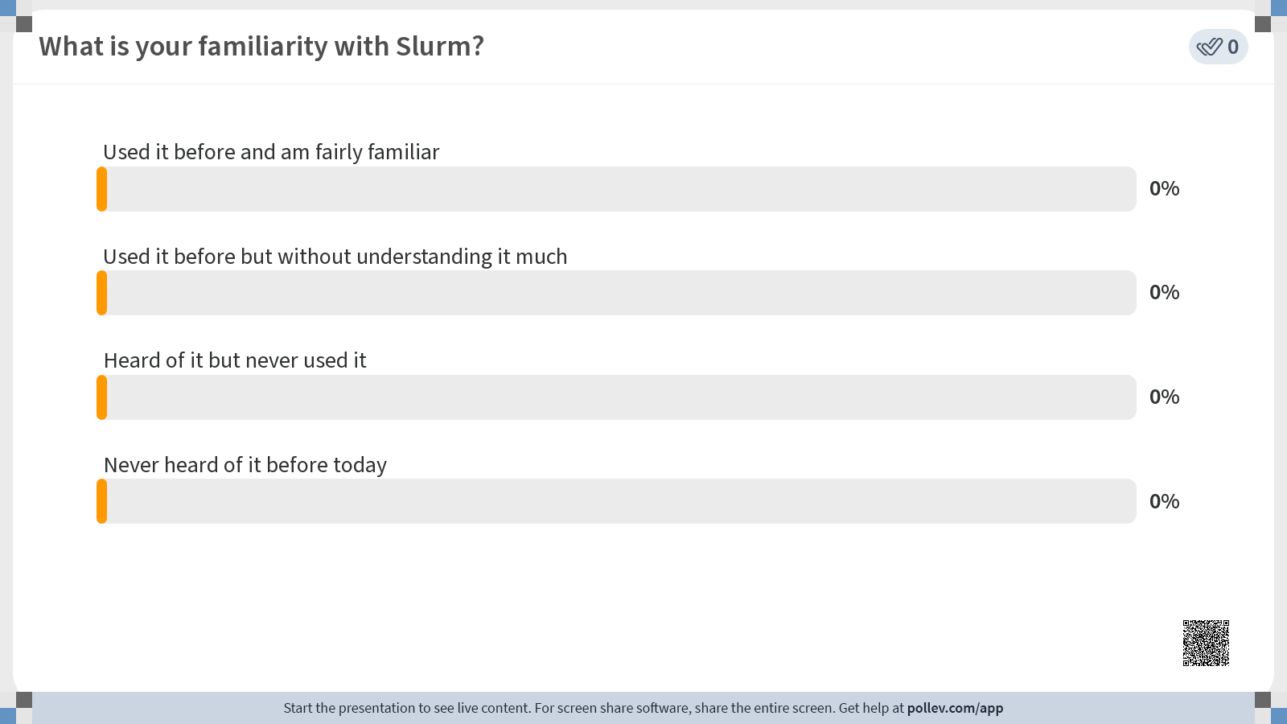

Slide 51
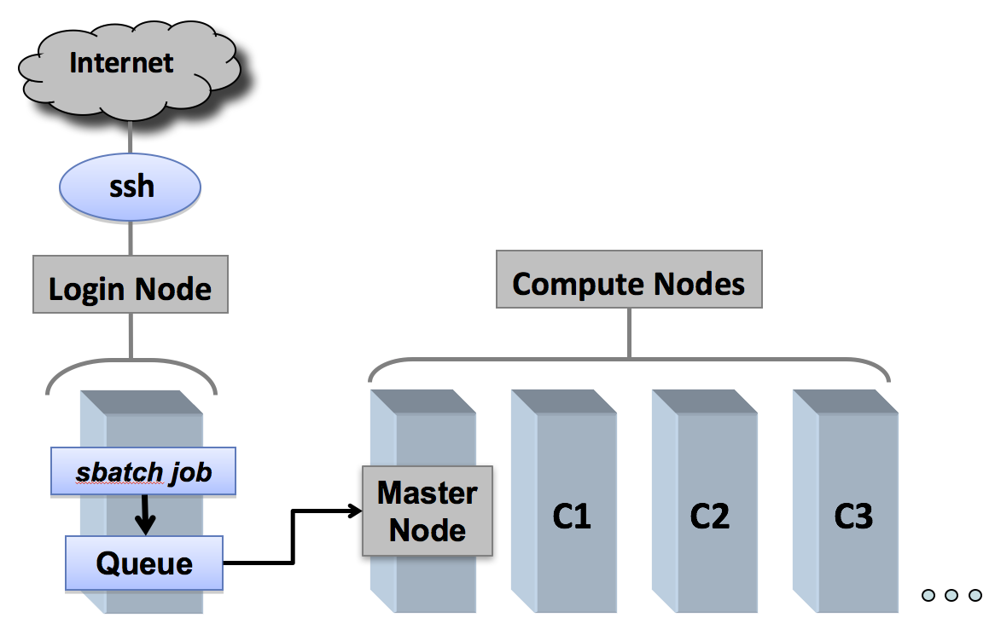
What is Slurm / Why Slurm?
Job allocation system
Fair allocation of compute resources
Exclusive access to nodes for performance measurements
Wide variety of machines to test on and run distributed programs on

Slide 52
Why use Slurm in CS3210?
SoC uses Slurm for our entire compute cluster
The best parallel computing systems use Slurm (>60% of TOP500)
A way to get good performance measurements when #hardware << #users → good for CS3210!
Do not run long jobs on login nodes anymore!

Slide 53
Disclaimers
Please let us know if there are any issues
Contact is in the tutorial sheet; it’s Sriram and Peigeng
If you contact me… my help is probably relaying to them unlesss it’s node down
Our “best practices” and policies may change. Please refer to https://bit.ly/cs3210-student-guide for updates

Slide 54
Go forth and try!
It’s not a race
Be curious
Screw things up
ex3 - ex12: Small guided exercises working through the basics
ex13: Basic performance evaluation with Slurm
Please bring up any interesting observations!
For me:
watch -n 0.5 squeue
watch -n 0.5 sprio

Slide 55
Special Topics in Slurm
Network Filesystem (NFS)

Slide 56
Special Topics in Slurm: NFS
It’s not a race
Be curious
Screw things up
Your home directory is configured in a network filesystem
Try: pwd (print working directory)
Pro: you get to access it from every node
Pro: as we have 6 nodes, one goes down your file is safe :D
Cons: might be slower
How much slower is NFS than node-local storage?
dd if=/dev/zero of=/nfs/home/theo/test.img bs=100MB count=1 oflag=dsync
dd if=/dev/zero of=/tmp/test.img bs=100MB count=1 oflag=dsync

Slide 57
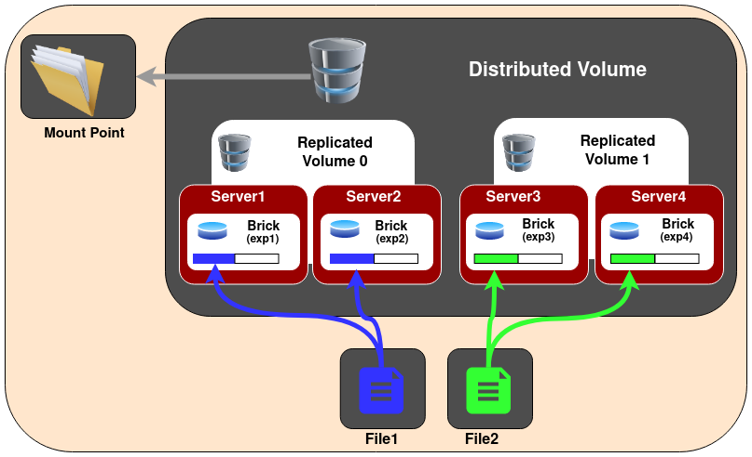
Special Topics in Slurm: NFS
It’s not a race
Be curious
Screw things up
We run a distributed + replicated NFS with “GlusterFS”
Many other alternatives! Go look it up :D

Slide 58
Special Topics in Slurm
Priority and Share

Slide 59
Special Topics: Priority and Share
It’s not a race
Be curious
Screw things up
Everyone run together: srun -w soctf-pdc-005 sleep 10
sprio -l
Who has more priority?
sshare –A students -a
Who’s been using the most?

Slide 60
Special Topics in Slurm
Slurm’s own broad runtime statistics

Slide 61
Special Topics: Broad runtime statistics
It’s not a race
Be curious
Screw things up
You can find some information about running job statistics with sstat
sbatch cond.sh
sstat -o jobid,nodelist,ntasks,avecpu,averss,maxrss,maxdiskread,maxdiskwrite <jobid>
But clearly better to use your own performance tracking for single jobs (perf, etc)

Slide 62
Special Topics II
Sneak Peek at Performance Evaluation

Slide 63
Sneak Peek at Performance Evaluation
It’s not a race
Be curious
Screw things up
Let’s try to measure how long a program takes
srun -p xs-4114 time ./pthread_addsub
srun -p xs-4114 /usr/bin/time -vvv ./pthread_addsub
srun -p xs-4114 perf stat ./pthread_addsub
srun -p xs-4114 perf stat -r 3 ./pthread_addsub
srun -p xs-4114 hyperfine -M 5 ./pthread_addsub

Slide 64
Sneak Peek at Performance Evaluation
It’s not a race
Be curious
Screw things up
Are there hardware differences?
srun -p xs-4114 hyperfine ./pthread_addsub > xs4114.out
srun -p dxs-4114 hyperfine ./pthread_addsub > dxs4114.out
srun -p i7-7700 hyperfine ./pthread_addsub > i77700.out
srun -p i7-9700 hyperfine ./pthread_addsub > i79700.out
srun -p xw-2245 hyperfine ./pthread_addsub > xw2245.out
tail -n +1 *.out (to see result)

Slide 65
Results
8 core i7-7700 CPU @ 3.60GHz:
8 core i7-9700 CPU @ 3.00GHz:
20 core Xeon Silver 4114 @ 2.20GHz:
20 core Dual-Socket Xeon Silver 4114 @ 2.20GHz:
16 core Xeon W-2245 @ 3.90GHz:
Notes:
The program is essentially single-threaded. All threads are adding to the same variable, so what matters is ultimately how fast each single thread in the CPU can go
xw:
Performance counter stats for './pthread_addsub' (3 runs):
4,358.36 msec task-clock # 0.953 CPUs utilized ( +- 1.64% )
4,040 context-switches # 898.337 /sec ( +- 0.64% )
323 cpu-migrations # 71.823 /sec ( +- 7.98% )
111 page-faults # 24.682 /sec ( +- 1.31% )
11,500,435,837 cycles # 2.557 GHz ( +- 0.18% )
6,046,566,089 instructions # 0.53 insn per cycle ( +- 0.00% )
2,009,196,286 branches # 446.766 M/sec ( +- 0.00% )
563,033 branch-misses # 0.03% of all branches ( +- 0.85% )
4.5735 +- 0.0721 seconds time elapsed ( +- 1.58% )
i77700
Performance counter stats for './pthread_addsub' (3 runs):
3,799.30 msec task-clock # 0.863 CPUs utilized ( +- 9.70% )
4,021 context-switches # 928.779 /sec ( +- 0.01% )
59 cpu-migrations # 13.628 /sec ( +- 13.75% )
115 page-faults # 26.563 /sec ( +- 0.50% )
10,958,218,455 cycles # 2.531 GHz ( +- 0.22% )
6,040,979,970 instructions # 0.55 insn per cycle ( +- 0.01% )
2,008,145,900 branches # 463.846 M/sec ( +- 0.01% )
928,683 branch-misses # 0.05% of all branches ( +- 1.56% )
4.403 +- 0.367 seconds time elapsed ( +- 8.33% )

Slide 66
Admin & Feedback
100% anonymous, anytime feedback at last slide
If you haven’t submitted Lab 1 - you still can! Just submit your best attempt :)

Slide 67
Summary
Parallel architectures
Flynn’s taxonomy
Memory, Processes vs threads
Slurm usage

Slide 68

End of tutorial 1
If you haven’t joined the telegram group: you’re missing out
Slides uploaded!
Feedback: bit.ly/feedback-theodore or scan below
Email: theo@comp.nus.edu.sg

